Slide 1

Group 18

Slide 2
Pipeline Stages

Slide 3
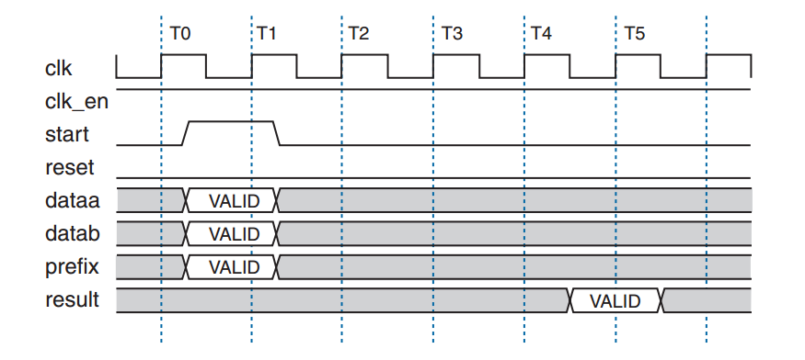
NIOS II Handshaking

Slide 4
CORDIC Stage’s Justification

Slide 5
CORDIC Accuracy

Slide 6
cos(11) Corner Case

Slide 7
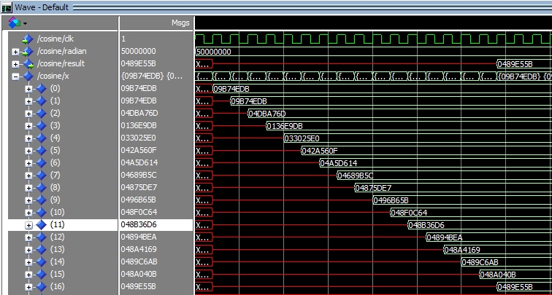
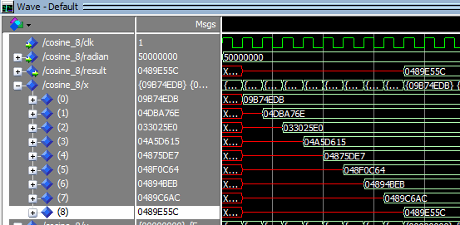
Unrolling the CORDIC

Slide 8
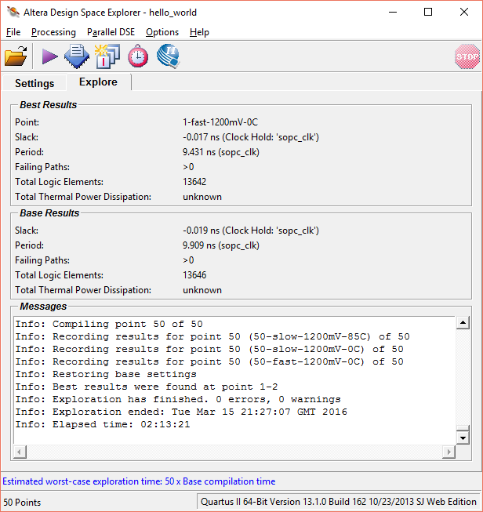
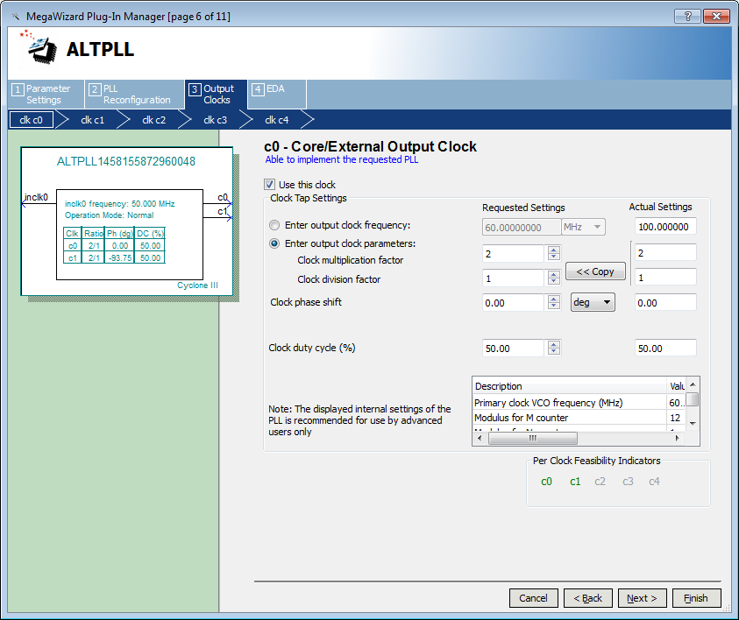
Seed Sweep

Slide 9
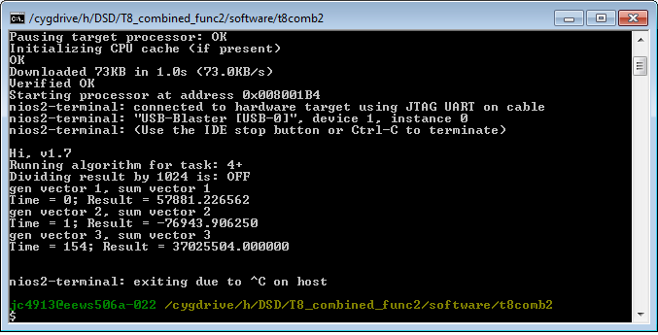
Software Optimization Level

Slide 10
cosine_blk : entity cos_wrapper_8 port map(
clk,
x,
cos_out,
clk_en
);
sq_block : ENTITY fpmul PORT map(
clk_en,
clk,
x,
x,
sq_out
);
mult_block : ENTITY fpmul PORT map(
clk_en,
clk,
sq_out,
cos_out,
mult_out
);
adder_block1 : ENTITY fpadd PORT map(
clk_en,
clk,
mult_out,
half_x,
add_out
);
adder_block2 : ENTITY fpadd PORT map(
clk_en,
clk,
add_out,
last_result,
result
);
end architecture main;
library ieee;
use ieee.std_logic_1164.all;
use ieee.numeric_std.all;
use work.all;
entity combined_func2 is
port(
clk : in std_logic;
x : in std_logic_vector(31 downto 0);
last_result: std_logic_vector(31 downto 0);
result : out std_logic_vector(31 downto 0);
clk_en : in std_logic
);
end entity combined_func2;
architecture main of combined_func2 is
signal exponent : std_logic_vector(7 downto 0);
signal half_x : std_logic_vector(31 downto 0);
signal cos_out : std_logic_vector(31 downto 0);
signal sq_out : std_logic_vector(31 downto 0);
signal mult_out : std_logic_vector(31 downto 0);
signal add_out : std_logic_vector(31 downto 0);
begin
sub_exponent : process(x)
begin
exponent <= std_logic_vector(signed(x(30 downto 23)) - 1);
end process sub_exponent;
div2 : process(exponent, x)
begin
if to_integer(signed(x)) = 0 then
half_x <= (others => '0');
else
half_x <= x(31) & exponent & x(22 downto 0);
end if;
end process div2;

Slide 11
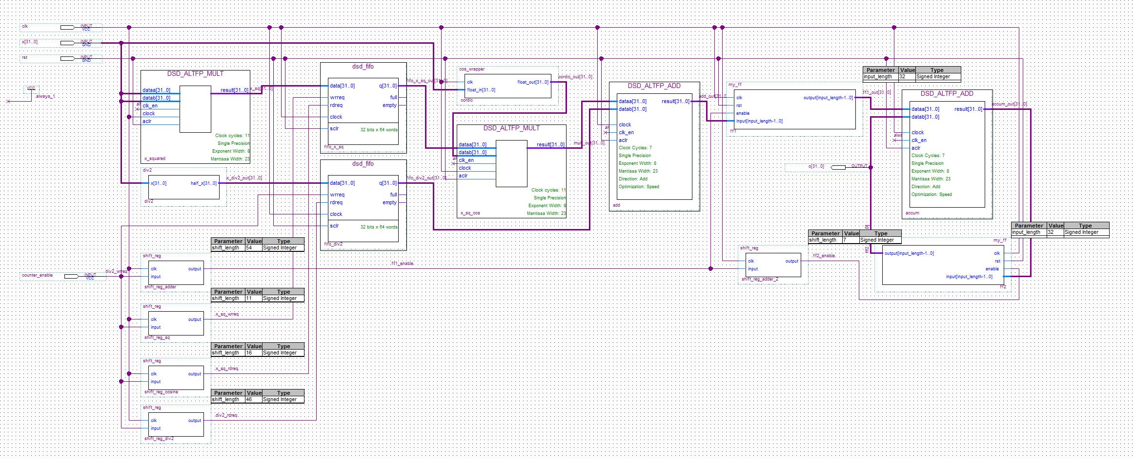
NIOS II ‘Hack’

Slide 12
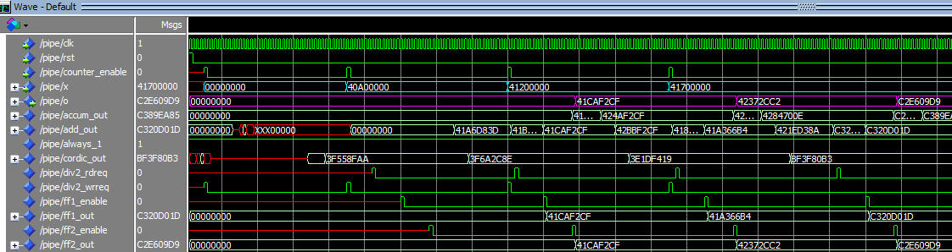
FIFO Pipe Simulation

Slide 13
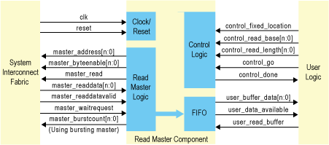
DMA Template

Slide 14
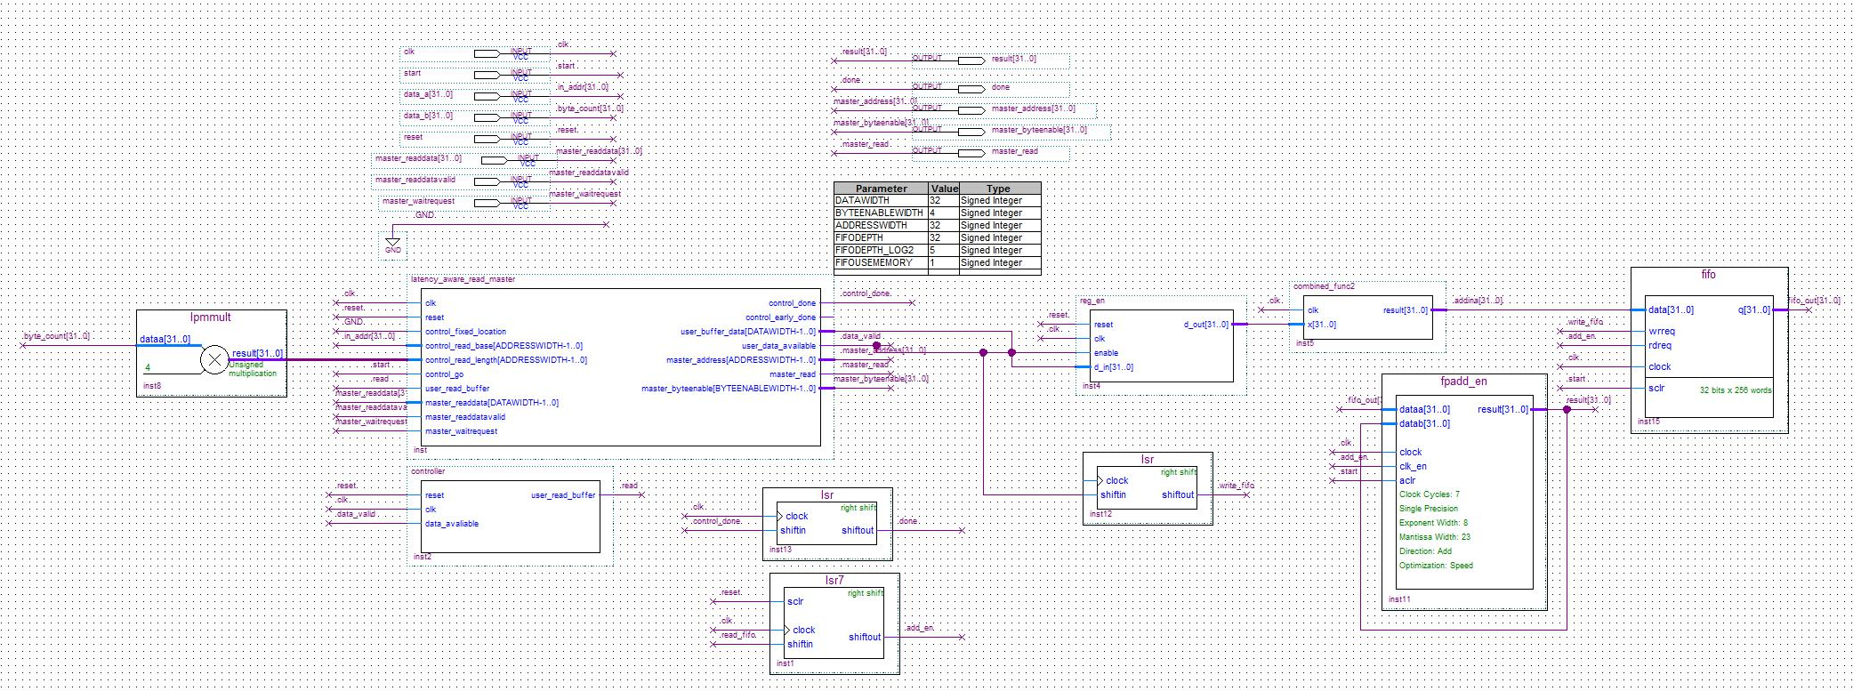
DMA BDF

Slide 15
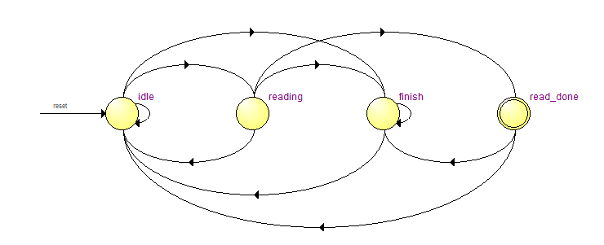
DMA Module FSM

Slide 16
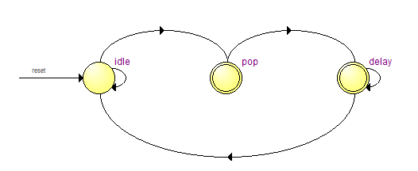
Accumulator FSM

Slide 17
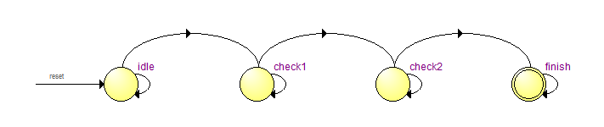
Overall FSM

Slide 18
library ieee;
use ieee.std_logic_1164.all;
use ieee.numeric_std.all;
use work.all;
entity pipeline is
port(
--custom instruction interface
clk : out std_logic;
reset : out std_logic;
start : in std_logic;
done : out std_logic;
clk_en : in std_logic;
in_addr : in std_logic_vector(31 downto 0);
n_byte : in std_logic_vector(31 downto 0);
result : out std_logic_vector(31 downto 0);
--mm interface
clk_mm : in std_logic;
reset_mm : in std_logic;
master_address : out std_logic_vector(31 downto 0);
master_read : out std_logic;
master_byteenable : out std_logic_vector(3 downto 0);
master_readdata : in std_logic_vector(31 downto 0);
master_readdatavalid : in std_logic;
master_waitrequest : in std_logic
);
end entity pipeline;
architecture main of pipeline is
signal transfer_done : std_logic;
signal ram_out : std_logic_vector(31 downto 0);
signal full : std_logic;
signal load_en : std_logic;
signal cordic_in : std_logic_vector(31 downto 0);
signal cordic_out : std_logic_vector(31 downto 0);
signal fifo_out : std_logic_vector(31 downto 0);
signal rdreq : std_logic;
signal fsm_wrreq : std_logic;
signal empty : std_logic;
signal fifo_wrreq : std_logic;
signal control_done : std_logic;
signal data_avaliable : std_logic;
signal delay : std_logic;
signal tmp_delay : std_logic;
constant tmp_count : std_logic_vector(31 downto 0) := std_logic_vector(to_unsigned(208, 32));
begin
--count_byte: entity counter
--port map(n_byte,clk_mm,start,rdreq,delay);
control_finish : entity fsm_finish port map(clk_mm, start, empty, control_done, delay);
tmp_delay <= '0';
DMA : entity MemRead port map(clk, reset, start, transfer_done, clk_en, in_addr, n_byte, ram_out,
clk_mm, reset_mm, master_address, master_read, master_byteenable, master_readdata, master_readdatavalid, master_waitrequest,
full, load_en, fsm_wrreq, control_done, data_avaliable
);
data_register : process
begin
wait until clk_mm'event and clk_mm = '1';
if load_en = '1' then
cordic_in <= ram_out;
end if;
end process data_register;
fifo : entity fifo_cordic port map(
start, clk_mm, cordic_out, rdreq, fifo_wrreq, empty, full, fifo_out
);
accum : entity accumulator port map(
clk_mm, fifo_out, start, empty, result, rdreq
);
count_finish : entity lsr34 port map(
start, clk_mm, clk_en, delay, done
);
delay_wrrqt : entity lsr26 port map(
start, clk_mm, clk_en, fsm_wrreq, fifo_wrreq
);
cordic_blk : entity combined_func2 port map(clk_mm, cordic_in, cordic_out, clk_en);
end architecture main;

Slide 19
Latency Improvement

Slide 20
Task 8 Latency Improvement

Slide 21
Table of Modifications
Task | Modification | Test Case 3 Latency | Test Case 3 Throughput | Latency Improvement from Reference Design (%) | Throughput Improvement from Reference Design (%) (%)
4 | Reference | 382038 | 166.8688717 | N/A | N/A
4.1 | 2KB->32KB Cache | 288024 | 221.33659 | 24.6085% | 32.6410%
5 | Embedded Multipliers | 136496 | 467.0484849 | 64.2716% | 179.8895%
6 | Add Floating Point Add/Mult | 114332 | 557.588864 | 70.0731% | 234.1479%
7 | Change cos() to hardware CORDIC | 2718 | 23454.83812 | 99.2886% | 13955.8499%
8 | Unroll CORDIC to 8*2 stages | 1373 | 46431.3547 | 99.6406% | 27725.0546%
8.1 | Convert all to block diagram hardware | 1024 | 62256.10352 | 99.7320% | 37208.3984%
8.2 | Use datab to reduce nested add | 1023 | 62316.95992 | 99.7322% | 37244.8680%
8.3 | Overclocking to 100MHz | 515 | 123786.8932 | 99.8652% | 74082.1359%
8.4 | Level 3 Optimization | 153 | 416668.3007 | 99.9600% | 249598.0392%
8.5 | DMA | 1 | 63750250 | 99.9997% | 38203700.0000%

Slide 22
float sumVector_cos_custom(float x[], unsigned int M)
{
float result=0.0;
int i=0;
for (i=0; i<M; i++){
result=ALT_CI_COMPUTE_0(x[i],result);
}
return result;
}
printf("gen vector 3, ");
generateVector(x3, N3, S3);
printf("sum vector 3\n");
float y3=0.0;
if (task) {t5 = times(NULL); y3 = sumVector_cos_custom(x3, N3); t6 = times(NULL);}
else {t5 = times(NULL); y3 = sumVector(x3, N3); t6 = times(NULL);}
gcvt(t6-t5, 10, c);
alt_putstr("Time = "); alt_putstr(c); alt_putstr("; ");
printf("Result = %f\n", ((div_1024)?y3/1024:y3));

